Slide 1

“Grocery Delivery
Website”
Task - 1

Slide 2
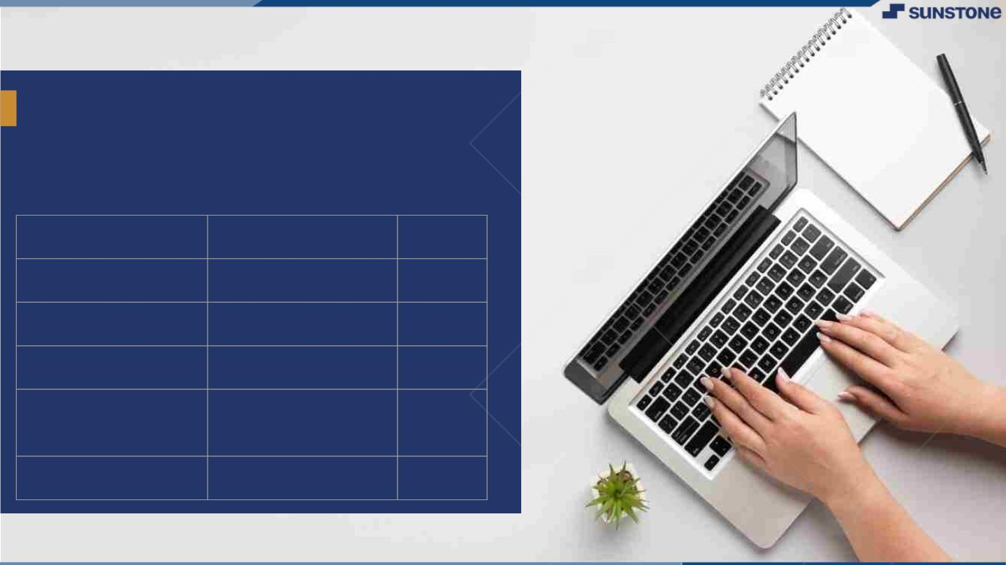
GroceryꢀDeliveryꢀWebsite
LMS Username
2108a33264
2108a33275
2108a33279
2108a33296
Name
Batch
A33
Akshaya V
Janani S
A33
Keerthana N
A33
Shabana Fathima
K
A33

Slide 3

Grocery Delivery Website
▪
Purpose
This document is meant to delineate
the features of OSS, so as to as a guide to
the developers on one hand and a software
validation document for the prospective
client on the other.
The grocery delivery web application is
intended to provide complete solutions for
vendors as well as customers through a
single get way using the internet.

Slide 4
Grocery Delivery Website
▪
Scope
This system allows the customer’s to
maintain their cart for add or remove the
product over the internet. This system makes
grocery delivery easy by adding their
address.

Slide 5
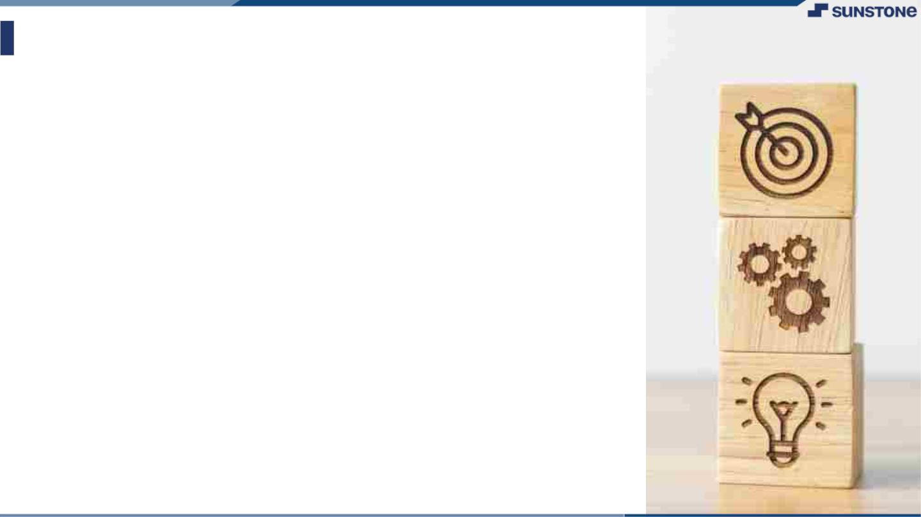
SRS for “Grocery Delivery Website"
▪
▪
Functional Requirements
This section provides requirement overview of the system. Various
functional modules that can be implemented bythe system will be
Description:
▪
▪
▪
Registration
▪
If customer wants to buy the product then he/she must be
registered, unregistered user can’t go to the shopping cart.
Login:
▪
Customer logins to the system by enteringvalid user id and
password for the shopping.
Changes to Cart
Changes to cart means the customer afterlogin or registration
▪
can make order or cancel order of the product from the
shopping cart.
▪
Payment
In this system we are dealing the mode of payment by Cash.We
will extend this to credit card,debit card
▪

Slide 6
SRS for “Grocery Delivery Website"
▪
▪
Functional Requirements
Logout
▪
After ordering or surfing for the product customer has to
logout.
▪
Report Generation
After ordering for the product,the system will sent one
▪
copy of the bill to the customer’s Email-address and
another one for the system data base.

Slide 7
SRS for “Grocery Delivery Website"
▪
▪
Non Functional Requirements
Following Non-Functional Requirements will be there in the
insurance to the internet:
▪
▪
▪
(i) Secure access to consumer’s confidential data.
(ii) 24X7 availability.
(iii) Better component design to get better performance
at peak time.
▪
▪
(iv) Flexible service based architecture will be highly
desirable for future extension.
Non-Functional Requirements define system properties
and constraints.
▪
▪
▪
▪
▪
▪
▪
▪
Various other Non-Functional Requirements are:
Security
Reliability
Maintainability
Portability
Extensibility
Resource utilization
Reusabilities

Slide 8
SRS for “Grocery Delivery Website"
▪
▪
Other interfaces
Performance Requirements:
▪
In order to maintain an acceptable speed at
maximum number of uploads allowed from a
particular customer as any number of users can
access to the system at any time. Also the
connections to the servers will be based on the
attributes of the user like his location and server will
be working 24X7 times.
▪
Technical Issues:
▪
This system will work on client-server architecture.
It will require an internet server and which will be
able to run PHP application. The system should
support some commonly used browser such as IE,
mozzila firefox,chrome etc.

Slide 9
SRS for “Grocery Delivery Website"
▪
▪
▪
Software Requirements
1.Operating System:Windows10 Ultimate which supports
networking.
2.JAVA development toolkit

Slide 10
SRS for “Grocery Delivery Website"
▪
▪
Hardware Requirements
Hardware requirements for insurance on internet will be same
for both parties which are as follows:
Processor:Dual Core.
RAM:2 GB.
Hard Disk:320 GB.
▪
▪
▪
▪
NIC:For each party.

Slide 11
SRS for “Grocery Delivery Website"
▪
▪
Description
The Online application enables vendors to set up online shops,
customers to browse through the shops, and a system
administrator to approve and reject requests for new shops and
maintain lists of shop categories. Also the developer is designing
an online shopping site to manage the items in the shop and also
help customers to purchase them online without visiting the
shop physically.The online shopping system will use the internet
as the sole method for selling goods to its consumers

Slide 12
SRS for “Grocery Delivery Website"
▪
▪
Summary
In short this document is to provide the detail overview of
our software product, its parameters and goals. This
describes about the website which is used to provide
complete solution for the vendors as well as the
customers. It enables the customer to browse their need
and add to cart. If the order is placed then the vendor can
deliver their groceries on time. It maker more for both
customer and vendors , their work will be done smoothly.
Whenever you purchase your groceries online you will be
able to shop any time of the day or night, at your own
convenience, regardless of what the weather outside may
be, and still get everything that you need and want.

Slide 13
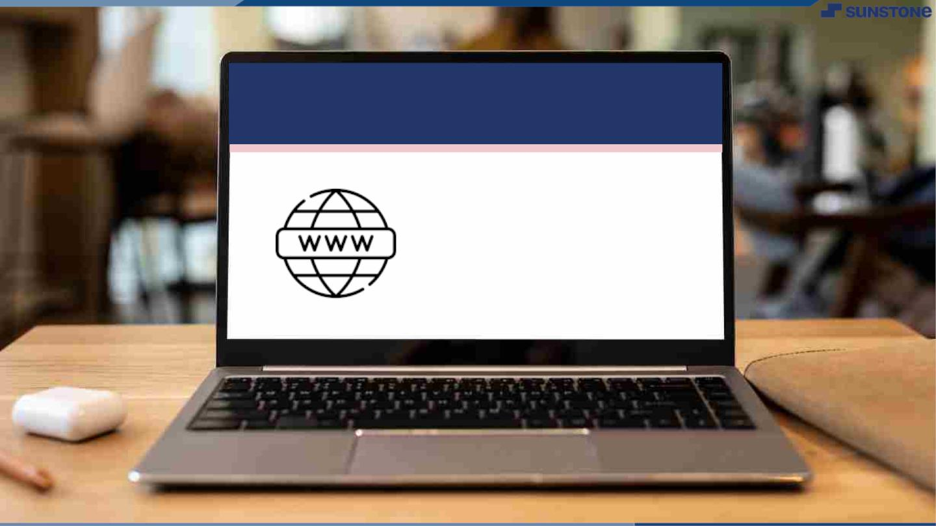
Submission Github
https://github.com/Akshu-
2003/grocery-delivery.git
Your github should contain this ppt,
readme file.

Slide 14


